Slide 1
Cotton Disease Prediction using Deep Learning
By: Deepak Saini
Kartik Sharma
Deep Kapadia
Parth Langalia

Slide 2
What is CNN?
Convolutional Neural Networks (ConvNets or CNNs) are a category of Neural Networks that have proven very effective in areas such as image recognition and classification.
ConvNets have been successful in identifying faces, objects and traffic signs apart from powering vision in robots and self-driving cars.

Slide 3
Reason to use CNN
If we use Artificial Neural Network (ANN) then it may not be able to predicted the right output because ANN requires an input in one column matrix.
If we convert an image into a column matrix then there are high chances that image will loss most of its important features because data is computed row-by-row manner.
In CNN, image is not converted in single column matrix. In this, data/image is computed in frame-by-frame manner.

Slide 4
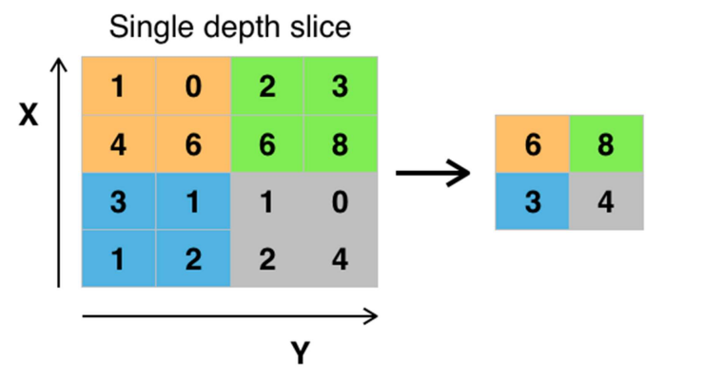
Max Pooling & how features are detected

Slide 5
Max Pooling & how features are detected (contd…)
The image above is an example of max pooling with a 2x2 filter and stride of 2. The four 2x2 colors represent each time the filter was applied to find the maximum value.
For example, [[1, 0], [4, 6]] becomes 6, because 6 is the maximum value in this set. Similarly, [[2, 3], [6, 8]] becomes 8.
Conceptually, the benefit of the max pooling operation is to reduce the size of the input, and allow the neural network to focus on only the most important elements.
Max pooling does this by only retaining the maximum value for each filtered area, and removing the remaining values.
Sum pooling, min pooling and Average pooling.

Slide 6
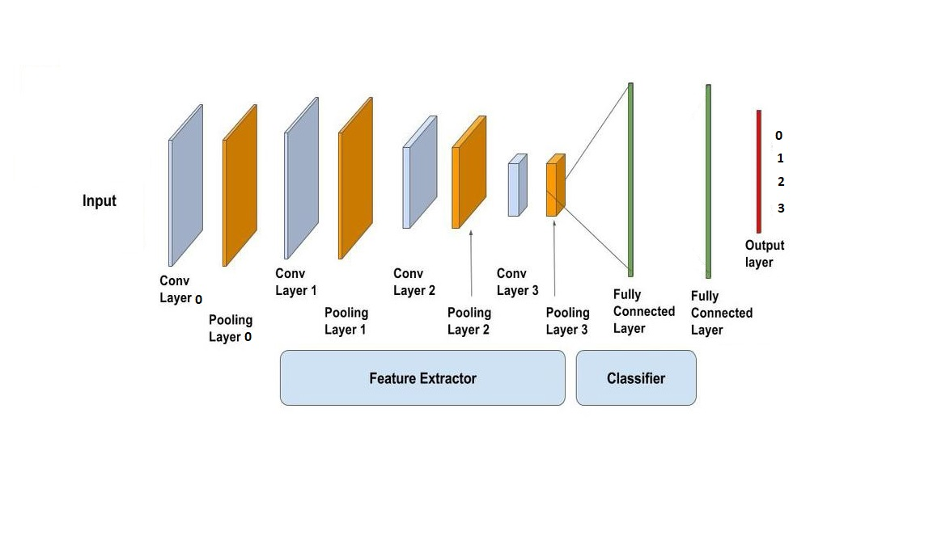
Architecture

Slide 7
Architecture (continued…)
In this, we have taken 4 convolutional layer, 4 Max pooling layer, 2 Neural Network layer and an Output layer.
Convolutional Layer and Max pooling layer are used to extract feature from the image.
And the next 2 neural network (fully connected layer) works as a classifier, which is used to classify an image to its corresponding class.
In neural network layer we have used “ReLu” activation function.
In output layer we have 4 classes and we have used “SoftMax” activation function.

Slide 8
Architecture (continued…)
This model is compile using “Adam” Optimizer (Loss Function).
Total number of “epochs” used to train the model is 300-500 (This is a hit-and-trial approach, it may require more numbers of epoch also).

Slide 9
Output Classes
0 : Diseased cotton leaf
1 : Diseased cotton plant
2 : Fresh cotton leaf
3 : Fresh cotton plant

Slide 10
Test Case
Srno./Classes | Image type | Observation | Result
0 | Diseased Cotton Leaf | Predict disease of leaf | Pass
1 | Diseased Cotton Plant | Predict disease of plant | Pass
2 | Fresh Cotton Leaf | Predict leaf is fresh | Pass
3 | Fresh Cotton Plant | Predict plant is fresh | Pass

Slide 11
Thank You

